Slide 1
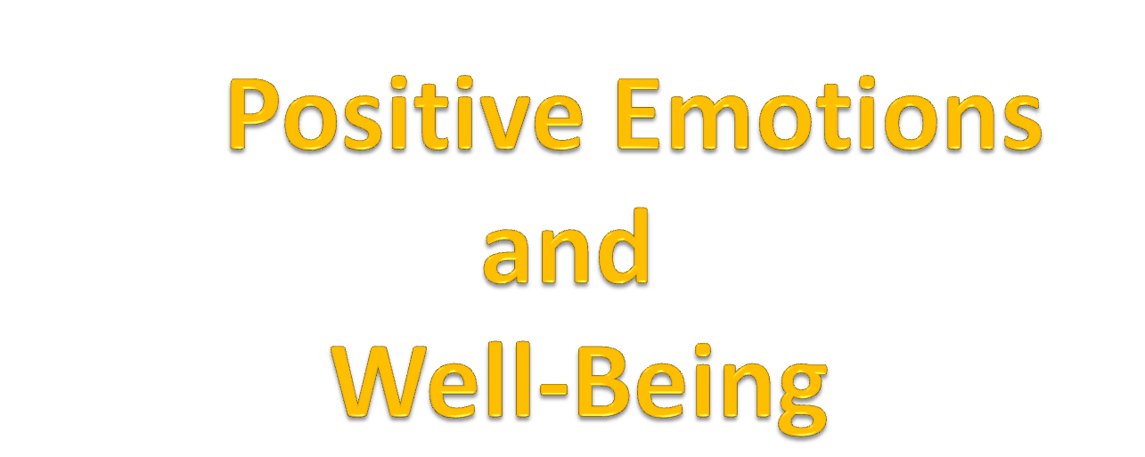

Slide 2
Affect and Emotion
Affect is a component of emotion and emotion is a more specific version of mood
Affect:
  A person’s immediate physiological response to a stimulus which is typically based on an underlying sense of arousal.
  Requires the appraisal of an event as painful or pleasurable and the experience of autonomic arousal
Emotion:
  Involve judgment about important things( appraising an external object for its salient features for our own well-being.)
  Our emotional responses occur when we become aware of painful and pleasurable experiences and associated autonomic arousal i.e. affect.

Slide 3
Historical Study of Emotions
More focus on negative emotions
- negative emotions can harm the body but also have survival value (Selye, 1936)
Less focus on positive emotions
- seen as having hedonic (pleasure-based) value only
Focus has gotten more balanced recently

Slide 4
Historical Study of Emotions
Development of the Positive and negative Affect Schedule PANAS by Watson & Clark
Measures both positive and negative affect
Positive and negative affect viewed as independent (not polar opposites)
Notes:
Make page correction here

Slide 5
The Study of Positive Emotions
Alice Isen, Cornell University
  when experiencing mild positive emotions, people are more likely to:
- help others
- be flexible in their thinking
- better problem-solve

Slide 6
General Theory of Positivity
According to Fredrickson and Losada, General Theory of Positivity predicts that the line dividing human flourishing from languishing among individuals and groups is strongly associated with the positivity ratio of 2.9. This has also been called the “Losada Line”, which is the ratio of positive to negative interactions to make a team or an effort successful( In other words, it takes three positive comments to fend off one negative comment)

Slide 7
Positive Emotions
I. Everyone “knows” about negative emotions.
Spend time & energy coping with negative emotions like stress, depression, loss, failure because:
Unpleasant
Bad for health
Negativity bias
II. Only recently recognized/researched the value of positive emotions.
Should value positive emotions because:
Pleasant
Good for health
As authentic as negative emotions
Research:
“Good times” more than offset negative emotions.
Enhance well-being even when not distressed.

Slide 8
What Are Positive Emotions?
Evolution: Capacity to feel variety of discrete & combined emotions
from anger & happiness to bittersweet.
Evaluate according to psychological & physiological effects:
Two basic forms: positive and negative
Positive = cheerfulness, joy, contentment, peace, happiness
Negative = anger, fear, sadness, disgust, guilt, contempt
Evidence:
1. Self reports - positive & negative consistently found to be underlying dimension - factor analysis - related to personality & well-being.
2. Physiological studies - positive & negative related to different outputs, hormones, brain activity, & arousal - i.e. bodies seem to be doing something different when we are in a positive emotional state versus when we are in a negative state.

Slide 9
Broaden-and-Build Theory of Positive Emotions
Barbara Fredrickson’s (2001) broaden-and-build theory of positive emotions provides an overview of how positive emotions build physical, psychological, and social resources.
The theory describes how positive emotions open up our thinking and actions to new possibilities, and how this expansion can help build physical, psychological and social resources that promote well-being.
Two distinctions are important:
Mood is a general concept then emotion
Positive emotions should not be confused with simple sensory pleasure

Slide 10
1. Mood and Emotion
  According to Fredrickson, Mood is a general concept than Emotion because it refers to our overall feelings, usually over a long period of time.
    When one says ,” I have been in a bad mood all week”, refers to making a statement about our general emotional state
  Emotions, in contrast, are more temporary states that are tied to personally meaningful events
    Getting an “A” on your term paper would express a particular emotion
  Emotion has a specific and sharpened quality as it always has an object and is associated with progress in goal pursuit while
  Mood is objectless, free floating and long lasting.

Slide 11
2. Positive emotions should not be confused with simple sensory pleasure
  Sensory pleasures are relatively automatic responses t physiological needs.
  In contrast positive emotions are more psychological in nature and depends on appraisal and meaning of events in people’s lives rather than physical stimulation in the body.

Slide 12
Broaden-and-Build Theory of Positive Emotions
1. Negative emotions and specific action tendencies.
Negative emotions produce urge to engage in specific action.
Fear to escape. Anger to aggress.
Adaptive from evolutionary/survival point of view - quick action.
2. Negative emotions narrow range of actions and thoughts to fit dictates of emotion…ways to escape…how to fight back.
3. What are we like when angry, unhappy, anxious?
More of single-minded focus on emotion and related behaviors.

Slide 13
Broaden-and-Build Theory of Positive Emotions
3. Positive emotions like joy are related to more diffuse, rather than specific behaviors and thoughts.
What does joy, happiness, contentment, & pleasure lead or urge you to do? No clear pattern, nothing, or many possibilities.
4. Broaden & Build Theory of Positive Emotions
Discrete positive emotions like joy, interest, contentment, pride, & love (rather than just general good mood).
All share ability to broaden our momentary thought-action repertoires and build enduring personal resources from physical and intellectual to social and psychological.

Slide 14
Four ways that positive emotions can broaden our thought-action repertoires and build our personal resources to increase well-being

Slide 15
1. Positive emotions broaden thought-action repertoires
Positive Emotions: the experience of joy/ joy expands/ broadens the momentary thought-action repertoires
Positive emotions - thinking more flexible, creative, big picture.
Negative emotions - narrow focus, miss big picture, e.g., when hurt or angry, leads to self-focused or Self-absorbed
Evidence: Research participants watched emotionally charged film clips-
A neutral, non emotionally charged clip served as a control condition.
After watching the film clip, participants were asked to think of a situation that created feelings similar to those aroused by the film clip.

Slide 16
1. Positive emotions broaden thought-action repertoires
Those who experienced joy, contentment rather than anger, fear…listed more desired possibilities…thus the expanded possibilities allow joyful individuals to initiate subsequent actions.
The broadening of thought-action possibilities, resulting from positive emotions, helps build intellectual resources for solving important life problems, because the more options we consider, the more likely we are to find an effective solution.

Slide 17
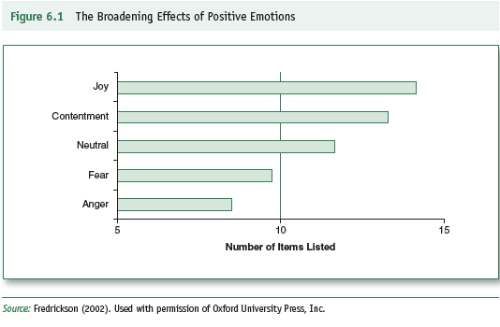
Broaden-and-Build Model
Research Support for Broadening
Notes:
Check figure number here

Slide 18
2. Positive emotions undo negative emotions
Positive and negative emotions are incompatible with each other, in the sense that it is hard to imagine experiencing both at the same time.
Combination of emotional feelings are possible, but the simultaneous experience of both intense positive and negative emotions seems unlikely.
Given this incompatibility, it is possible that positive emotions might undo the effects of negative emotions.

Slide 19
2. Positive emotions undo negative emotions
Evidence:
Situation: Students were asked to prepare speech for one minute on ‘why are you a good friend’, They were supposed to give speech live, and which will be video-taped, evaluated by peers – This led to pounding heart. This was measured using heart rate and blood pressure.
- after the preparation, students were assigned to one of four film conditions.
One group of students watched a short film that was emotionally neutral
A second group of watched a film selected to induce mild joy
A third group watched a film selected to produce mild contentment
A fourth group watched a film selected to evoke sadness.
-

Slide 20
2. Positive emotions undo negative emotions
The researchers measured how much time it took students to return to baseline levels of cardiovascular activity.
As predicted, students in the joy and contentment film conditions returned to baseline significantly faster than those in the neutral or sad conditions.
The sad film was associated with the longest recovery time.
The experience of joy and contentment apparently helped undo the cardiovascular effects of the anxiety caused by the speech-preparation task.

Slide 21
3. Positive emotions enhance resiliency
Resilience is the ability to bounce back from stressful events and regain composure and a sense of well-being.
Positive emotions may increase our resilience and ability to cope by offsetting the effects of negative emotions caused by stressful experiences.
Evidence: Resilient people experience more and use positive emotions.
Speech preparation task - resilient students more positive emotions and faster cardiovascular recovery. Resilient people “laugh” in face of stress.

Slide 22
4. Positive emotions build enduring resources and improve well-being
Positive emotions may create a comparable upward spiral of well-being.
Positive emotions broaden our outlook , offset negative emotions, enhance our resilience, and improve our emotional well-being.
A broadened outlook and increased resilience may, in turn, increase the experience of positive emotions, and son on.
In short, positive emotions may help build our physical resources for fighting disease, our individual psychological resources for coping with stress, and our social resources (in the form of support from others) that are important in dealing with nearly all life challenges.
Fredrickson referred to this positive sequence as “upward spiral” of positive emotions

Slide 23
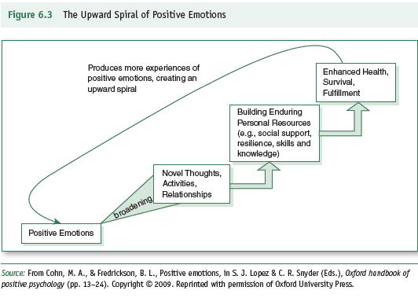
Broaden-and-Build Model
Research Support for Building
Notes:
Reference figure number here

Slide 24
4. Positive emotions build enduring resources and improve well-being
Opposite of downward spiral of depression - depressed mood, negative thinking, more depression, ruminating, recall bad memories, self-focus, etc.
Positive emotion - upbeat & flexible thinking, better problem-solving, higher resilience, broader view of life, engender/produce social support from others

Slide 25
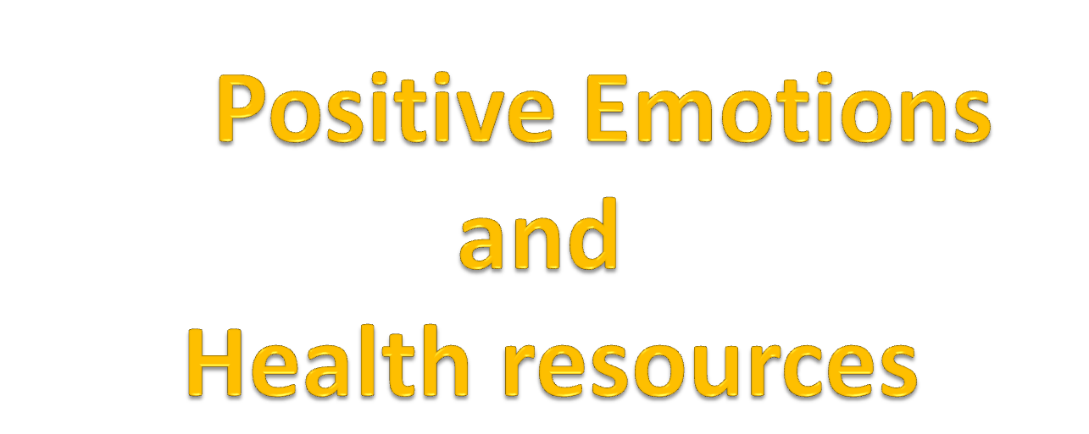

Slide 26
Positive Emotions & Health
Physical resources
Psychological resources to cope with stress/tragedy.
Finding the positive in negative
Social resources

Slide 27
Positive Emotions & Health
Negative and positive emotions have the
potential to set in motion a variety of physical,
psychological, and social changes that can either
compromise or enhance or health.
Positive emotions contribute to the enhancement of our health resources and negative emotions contribute to their depletion.

Slide 28
Positive Emotions & Health
Physical resources involve the health and integrity of the body and the strength of the body’s defenses against disease.
Psychological resources refer to the effectiveness of people’s responses in dealing with stressful experiences and the personal qualities they possess that provide strength and resilience in facing life challenges.
Social resources refer to the number and quality of relationships with others that provide support in times of need.

Slide 29
1. Physical resources
I. Positive Emotions and Physical Resources
Physical resources involve four systems: The brain, the nervous system as a whole, the endocrine system, and the immune system.
Many researchers have targeted the immune system as a major pathway for the effects of emotions on health.
The primary purpose of immune system is to destroy or neutralize pathogens that might make us sick.

Slide 30
Mechanisms
Direct effects of emotional states on immunity and illness
Negative emotions suppress immune system and associated with unhealthy physiological functioning.
Positive emotions enhance immune system functioning and associated with healthy functioning.
E.g., Cohen - systematic exposure to respiratory virus produced more severe illness among those in negative mood versus positive mood.
Brain and immune system connected through hormones
flowing through blood and by neurotransmitters within brain and nervous system. Different moods increase or decrease release of antibodies/hormones/transmitters that fight disease.

Slide 31
Immune System
Our body’s cellular defense against illness contains different cells to identify and kill foreign invaders like viruses, bacteria, and tumor cells. Suppressed or enhanced by moods.
Research:
(only last 15 years measured at specific physiological level)
- S-IgA - secretory immunoglobulin A - antibody - first line of defense against common cold.
-Positive moods enhance release & negative reduce release.
- Desirable events increase levels of S-IgA for several days.
- Labott & colleagues – exposure to funny or sad video raised or
lowered levels of S-IgA.
- Humor used as defense mechanism - higher baseline S-IgA.

Slide 32
- T-cells & NK cells within immune system
T-cells - recognize invaders, like measles - multiply rapidly and kill invaders.
NK cells - kill anything foreign within body.
Negative mood, stress, depression, helplessness, reduce number and effectiveness of T- and NK cells.

Slide 33
Research Examples
Kiecot-Glaser & Glaser - Psychosocial moderators of immune function. Annals of Behavioral Medicine, 9, 16-20.
1. Measured level of stress, monitored immune system, and tracked health over time.
2. Medical students - baseline levels of stress & immune system functioning right after vacation (low stress).
3. Same measures during several important exam periods.
4. Findings: as stress levels went up, effectiveness of immune system went down. More reported illness like respiratory infections during exam periods.

Slide 34
Stone, Neale, Cox, Napoli, et al. – Daily events associated with secretory immune response to oral antigen. Health Psychology, 13, 440-446.
1. 48 adult men kept daily diaries of moods and experiences at work, home, leisure, finances, and relationships with spouses, children, relatives, and co-workers.
2. Antigen pill taken each day for 12 days of study. Harmless protein that cause production of antibody - measure of defense against foreign agent.
3. Daily saliva samples take to measure antibody response.
4. Findings: More positive events and emotions men experienced more production of antibody. More negative events and emotions less production of antibody.

Slide 35
2. Positive Emotions and Psychological Resources
Psychological resources for managing stress involves the strength and effectiveness of our intellectual, behavioural, and emotional efforts to reduce and offset stressful experiences.
Positive Emotions and Active/Proactive Coping
Positive and negative emotions co-occur even in cases of severe illness. Not always stressed or depressed.
Healthy coping means dealing with negative emotions but also cultivating positive emotions.

Slide 36
Benefits of positive emotions
Associated with problem-solving oriented coping rather than avoidance or denial. Doing little things overcome hopelessness.
Associated with pro-active coping…preventing a problem before it occurs or gets serious.
-Bolster positive resources…optimism, confidence, imaginative thinking, meaningfulness, positive life lessons.
Examples
Finding ways to experience joy, laughter, peacefulness, through shared memories, time with others…

Slide 37
3. Focus on Application: Finding the positive in negative
Folkman and Tedlie Moskowitz (2000) describe three kinds of coping that generate positive affect: Positive Reappraisal, goal-directed focused coping, and infusing ordinary events with positive meaning.
Positive reappraisal – Positive reappraisal refers to a cognitive strategy that reframes the problem in a more positive light.
Example: Caregivers of terminally illness patients believed that their efforts were both valued and worthwhile.
These positive reappraisals were associated with increase in positive mood for the caregivers.

Slide 38
3. Focus on Application: Finding the positive in negative
Problem-focused Coping: Problem-focused coping refers to actions taken to reduce the distress of a painful situation.
Example: Caregivers of terminally illness patients focused on smaller problems they could solve, such as changing aspects of living arrangements to make the patients more comfortable; arranging planned outings; managing medications; preparing food; or planning entertainment activities.
Solving problems encountered in the daily activities of caregiving contributed to a sense of personal effectiveness, mastery, and control.

Slide 39
3. Focus on Application: Finding the positive in negative
Infusing ordinary activities with positive meaning
Caregivers of terminally illness patients realized that after doing the things for their close ones, they had both positive feelings and a sense of purpose and personal meaning.
Caregivers also reported unplanned events and experiences, such as receiving a compliment for a small task or encountering something like a beautiful flower.
These events added a bit of cheer and good feeling to the daily routine of caregiving.
Each of these ordinary activities, infused with positive meaning, produced positive feelings and helped caregivers make it through the day.

Slide 40
4. Positive Emotions and Social Resources
Social support - involvement in caring relationships consistently associated with better health outcomes.
Social support
Practical help, disclosure, intimacy, enjoyable experiences, confidence, and strength from safety net.
Alameda County, Calif. study - Berman & Syme
7,000 people studied for 9 years. All aspects of health measured.
Active involvement in positive relationship with friends and families beat out smoking and obesity as predictors of longevity and health.
Socially active 2 to 3 times more likely to be alive over 10-year period

Slide 41
4. Positive Emotions and Social Resources
Two Hypotheses
Buffering Hypothesis - social support only useful when experiencing stress/crisis. Buffers/reduces bad effects of toxic emotions.
e.g., disclosure & trauma research
Direct Effects Hypothesis - social support. Relationships contribute to health whether or not experiencing stress…Good relations make us happier and healthier independent of stressful life experiences.
The health benefits of social support may stem from the positive emotions associated with close relationships and the feelings of security that come from the knowledge that people care about you and will be there when you need them. These positive feelings may, in turn, enhance immune-system functioning.

Slide 42
Reciprocal Relationship
Positive emotions cause and consequence of supporting relationships.
-Social support contributes to positive emotional states.
Relationships most powerful predictor of happiness.
-Positive emotional states “attract” relationships.
Happy people have more friends.
Easier to help/support upbeat person than depressed or moody person.
Negative mood reduces likelihood of help from others.

Slide 43
Limits of Positive Emotions
1. Effects of positive emotions are relative not absolute.
Not “had cancer and laughed yourself well,” i.e., cured.
2. Comparative standard - compared to what?
Compared to effects of negative emotions or absence of positive
emotions.
3. Other things being equal - will do better with positive emotions.
Better than what? Better than with negative emotions or no positive emotions.

Slide 44
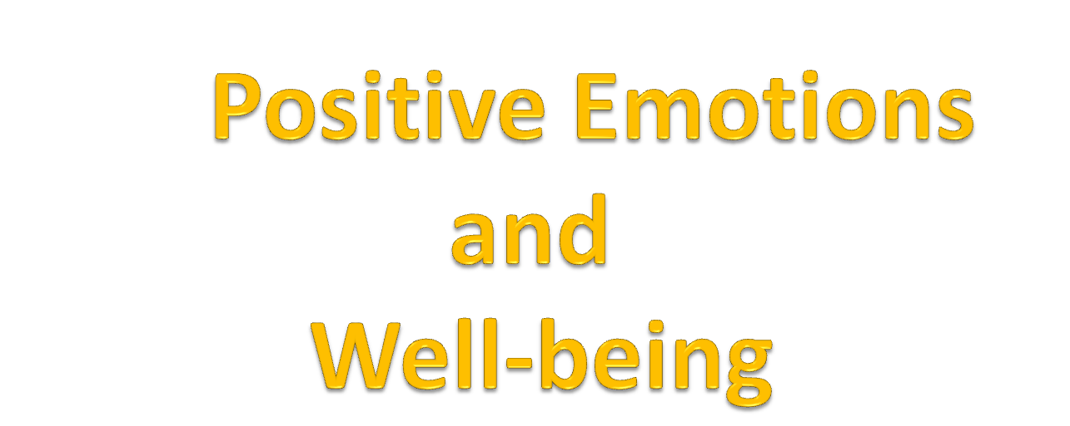

Slide 45
Positive Emotions & Well-being
Happiness and Positive Behavior
Positive emotions and Success
Positive emotions and Flourishing

Slide 46
Happiness and Positive Behavior
A number of studies show that people in a positive mood act quite differently than when they are in a bad mood or experiencing a distressing emotion.
Happy people are more tolerant and less prejudicial, more compassionate, more focused on others rather than self-focused, more helpful to others, and more enjoyable to be with (Isen, 2003; Myers, 1992).
Happiness might be viewed as a desirable state in and of itself because it is linked to so many positive behaviors.
Happiness seems to produce a more expansive view of the world.

Slide 47
Positive Emotions & Success
Benefits of Frequent Positive Affect: Does Happiness Lead to Success? Sonja Lyubormirsky, Laura King & Ed Diener (2005)
Conceptual Model
1. Positive affect - related to:
confidence, optimism, self-efficacy, likeability, positive views of others, sociability, activity & energy, prosocial behavior, immunity & physical well-being, effective coping with challenge & stress, originality & creative thinking.

Slide 48
2. Each attribute contributes to active engagement & approaching, rather than avoiding problems, and tackling new important personal goals. (opposite of negative emotions)
3. Because happy people experience more frequent PA they are more likely to work actively and successfully on new goals.
4. Happy people build up resources and skills to increase future effectiveness (Broaden & Build theory).

Slide 49
Evidence
Hundreds of studies
1. Cross-sectional studies
  Are happy people successful people?
  Long-term & short-term happiness associated with adaptive skills?
  2. Longitudinal studies
  Does happiness precede success?
  Does happiness precede development of adaptive skills?
  3. Experimental studies
  Does induced positive affect lead to success behaviors?
  Areas of Research
  Employment & quality of work & income
  Community involvement
  Social relationships, marriage, friendships, social support
  Health: physical and mental
  Sociability & extraversion, likeability, pro-social behavior
  Coping with stress & challenge
  Originality, imagination, flexibility
  Correlations: r = .3 to .5
  Experimental studies: consistent ”successful” effects

Slide 50
Positive Emotions & Flourishing:
Complete mental health can be conceptualized via combinations of high levels of emotional well-being, psychological well-being and social well-being. Individuals with these high levels are described as flourishing.
Flourishing is a state of optimal functioning that is at the opposite end of continuum from mental illness.
Diagnostic criteria for flourishing
Individual must have had no episodes of major depression in the past year.
High emotional well-being defined by 2 of 3 scale scores
High psychological wellbeing, defined by 4 of 6 scale score
High Social well-being, defined by 3 of 5 scale scores

Slide 51
Positive Emotions & Flourishing:
A General Theory of Positivity?
Fredrickson & Lasada - American Psych. - 05
-Broaden & Build Theory of Positive Emotions
Positive emotions enhance life, offset negative emotions, build coping resources, creativity, and health.
Research: 1000s of people..weeks to months
IV: Over time: Experience sampling, work teams, families.
Measure ratio of positive to negative emotions.
e.g., 10 positive to 3 negative in a day = 3.33
3 positive to 10 negative = .30
DV: Measures of flourishing, optimal functioning, vitality.
Consistent Result: Ratios of 2.9 or higher (3 times + vs. -)
Critical threshold dividing health and optimal functioning versus languishing & ill health.
2.9 index or symptom processes expressing a life well-lived.

Slide 52
Cultivating Positive Emotions: Flow Experiences
Engaging in particular life activities = Happiness
Mike Csikszentmihaly
- flow = engagement in interesting activities that match or challenge one’s skills and abilities.
- engagement produces happiness

Slide 53
Cultivating Positive Emotions
Flow Experience: Getting Out of Our Minds
1. Highly effective - active state
2. Destroyed by conscious thinking
3. Good for you - relieves stress
4. Natural altered state of consciousness
  “out of your 8-to-5 mind”

Slide 54
Flow Experience
Normal Mind (8-to-5) Out of Your Mind
Duality Oneness
Self-Control Loss of self
Attention wanders Total absorption
Internal talk Talk destroys
Confusion Clarity of action
Time conscious Time flies - frozen
Negative emotions Exhilaration
Stress accumulates Discharge stress

Slide 55
Requirements of Flow
1. Well-learned activity - automatic
2. Produces total absorption and shuts off conscious thinking
3. Thinking destroys the flow experience

